Slide 1

Area segmentation algorithms – A geoinformatic approach to Geomarketing strategies
Master Thesis in cooperation with
microm Micromarketing-Systeme und Consult GmbH
[1]
Sabine Schmidt, Msc. Geoinformatics
Notes:
Aim: implement a function in the web tool of microm → customers can do marketing analysis there
Microm: geomarketing company

Slide 2

Agenda
Introduction Geomarketing
Motivation and Research Question
Approach
Architecture
Progress
Outlook
AGENDA
2
[2]
[1]

Slide 3

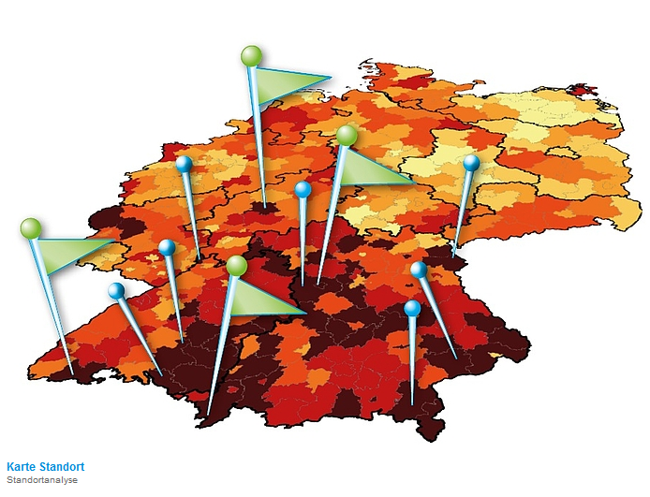
Introduction Geomarketing
Introduction
Motivation
Approach
Architecture
Progress
Outlook
Connection of information in a spatial way to support marketing decisions of companies
[3]
3
[1]
[1]
Notes:
- Connects information with spatial reference system → statistical analysis can be done → support decisions

Slide 4
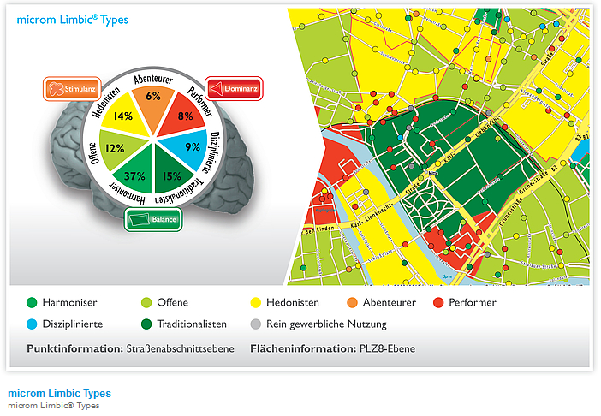
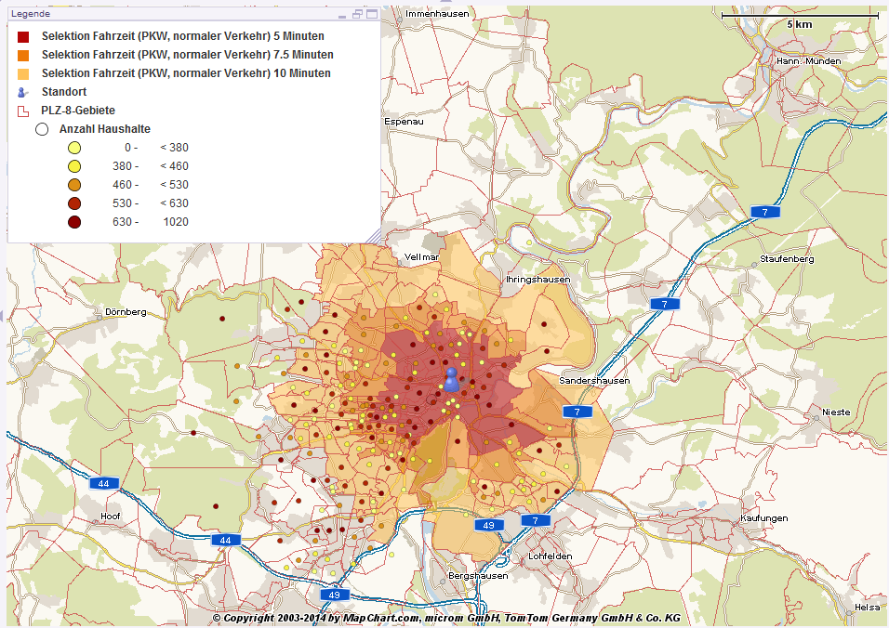
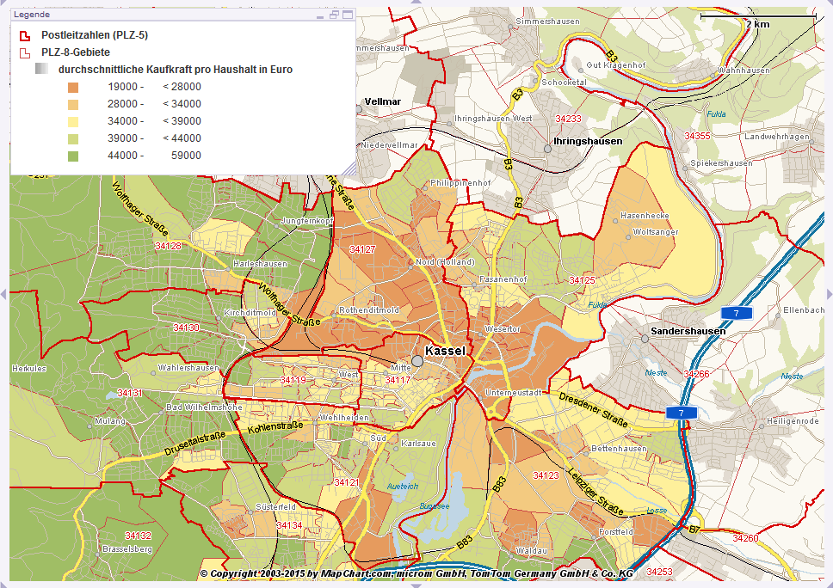
Introduction Geomarketing
Introduction
Motivation
Approach
Architecture
Progress
Outlook
Geomarketing
Routing, Competition observation,
…
[1]
Analysis of Audience
4
[1]
[1]
Catchment Areas
Location Planning
[1]
Notes:
Analysis of audience:
Question which are considered:
How to get new costumers in a effective way?
How to optimize management of costumer care?
How does the lifestyle of somebody effects my product planning?
→ for example: identify lifestyle of persons to see where adventourus persons live → globetrotter/outdoor store advertising there
Catchment Areas:
How many people can be reached in a specific time?
How much number of housholds are there?
→ Determine catchment area of the company → not reasonable to open company on a field where now person can reached it → sales can be calculated
Location Planning:
New location?
Competition there?
Several new locations? How to distribute to have same number of household --> important for master thesis

Slide 5
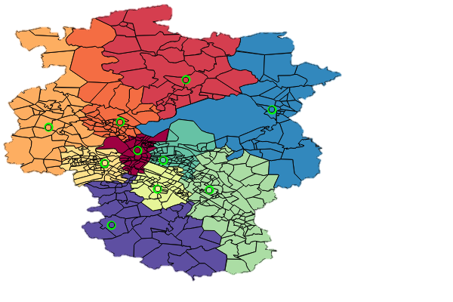
Use Case – Planning Marketing and sale areas
Introduction
Motivation
Approach
Architecture
Progress
Outlook
As a company owner I would like to plan marketing and sale areas for my employees to define areas of responsibility while considering predefined criterias.
5
Notes:
Distribute whole area in areas of responsibility
Every employee should be responsible for one area

Slide 6
Use Case – Planning Marketing and sale areas
Introduction
Motivation
Approach
Architecture
Progress
Outlook
As a company owner I would like to plan marketing and sale areas for my employees to define areas of responsibility while considering predefined criterias.
Criteria
Equal workload
Coherent areas
6
Equal purchasing power
Notes:
Coherent areas to minimize travelling time from one costumer to next one

Slide 7
Use Case – Planning Marketing and sale areas
Introduction
Motivation
Approach
Architecture
Progress
Outlook
As a company owner I would like to plan marketing and sale areas for my employees to define areas of responsibility while considering predefined criterias.
Input
Area: Post zip codes, customers…
Number of locations
Take locations: Area Segmentation
7
Create location(s): Greenfield- / Whitespotanalysis

Slide 8

Use Case – Planning Marketing and sale areas
Introduction
Motivation
Approach
Architecture
Progress
Outlook
As a company owner I would like to plan marketing and sale areas for my employees to define areas of responsibility while considering predefined criterias.
How to create areas?
8
[7]

Slide 9
Use Case – Planning Marketing and sale areas
Introduction
Motivation
Approach
Architecture
Progress
Outlook
As a company owner I would like to plan marketing and sale areas for my employees to define areas of responsibility while considering predefined criterias.
Area segmentation algorithm needed!
How to create areas?
9
[7]

Slide 10

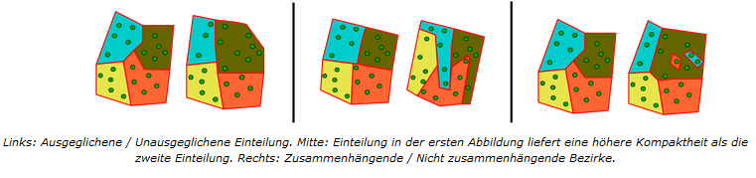
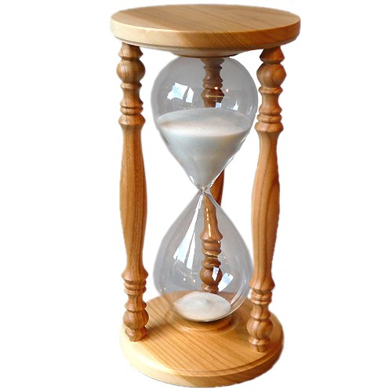
Motivation and Research Question
Introduction
Motivation
Approach
Architecture
Progress
Outlook
[4]
Problems of available tools
Areas not coherent
Slow calculation
Bad compactness rate
Criteria not balanced
[9]
[10]
10
[9]
[9]
[1]
Notes:
Criteria like purchasing power or number of households
Not balanced: using threshold
Possibility to weight criterias like compactness and balance

Slide 11
Motivation and Research Question
Introduction
Motivation
Approach
Architecture
Progress
Outlook
[4]
Problems of available tools
Areas not coherent
Slow calculation
Bad compactness rate
Criteria not balanced
Which area segmentation approach is the most promising
one for the application to Geomarketing strategies
considering the desired conditions?
11
[1]

Slide 12

Approach
Introduction
Motivation
Approach
Architecture
Progress
Outlook
Comparison and implementation of different algorithms
8 different algorithms
Use of decision matrix for comparison
Application of one algorithm to Geomarketing strategies
12
[5]
[1]
Notes:
Approaches developed by me and through ideas from employees of microm
Just few number of existing → not available → companies sell for lot money

Slide 13

Architecture
Introduction
Motivation
Approach
Architecture
Progress
Outlook
Input
Processing
Output
Data provided by microm
Eclipse
QGIS
Geometries
PostgreSQL/PostGIS
Number of Households
Java
13
- Locations
JavaFX
[6]
[1]
Notes:
Data as Input
Area postzip geometries
SPK locations to work with real data
Algorithm implemented in eclipse
Uses PostgreSQL database
Implemented in JAVA
JavaFX GUI for microm
Results saved as shapefiles for visualizing; shown in QGIS

Slide 14
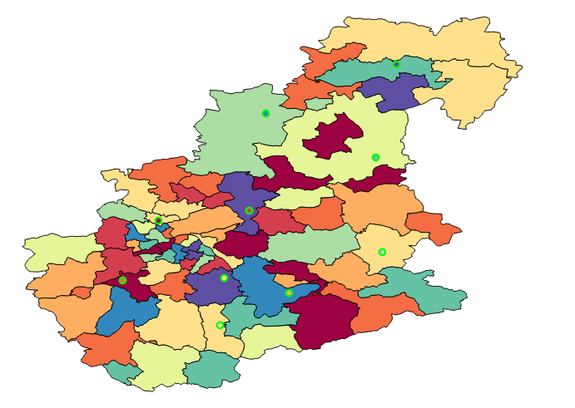
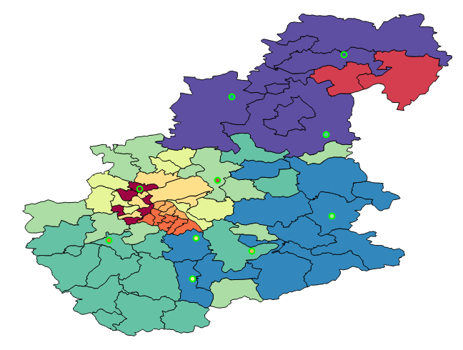
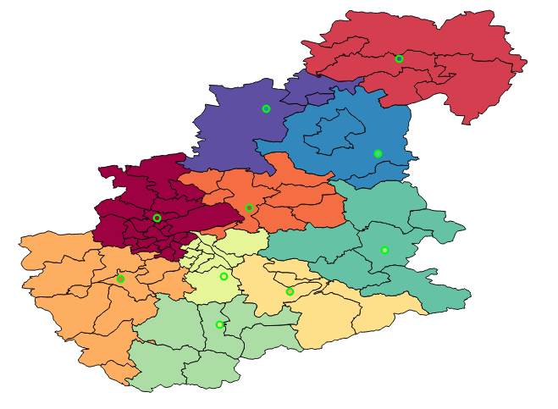
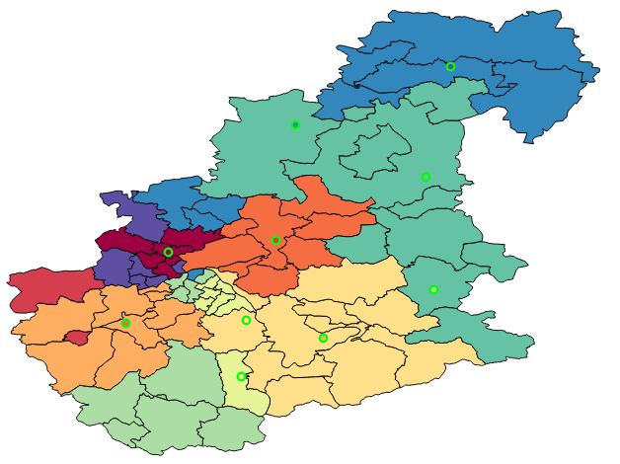
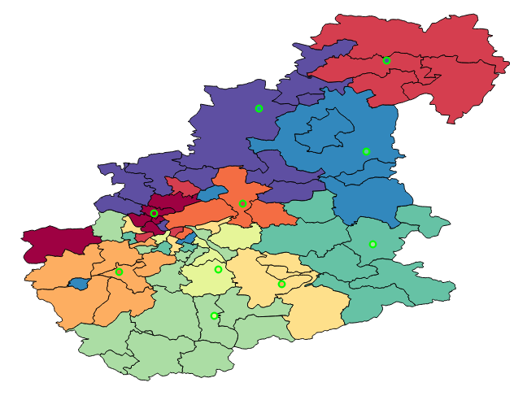
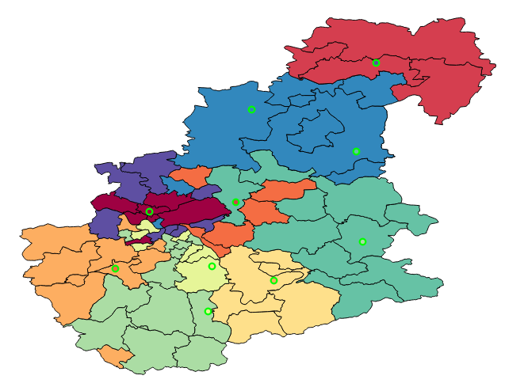
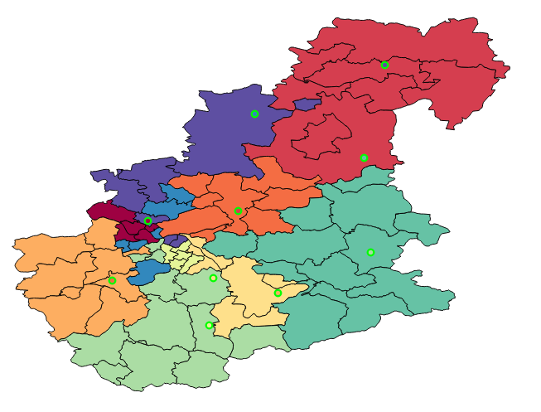
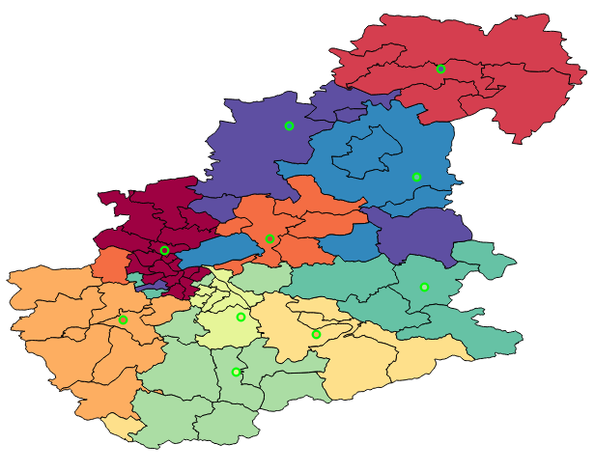
Progress
Introduction
Motivation
Approach
Architecture
Progress
Outlook
[5]
JustCrit
SumDivNumber
JustDist
SumDivNumberDist
14
CritDistInOut
CritDistInOutTrueNearest
DistCrit
CritDistOutInInOut
[1]
Notes:
8 different algorithms implemented
Compared considering runtime, compactness and distribution
Compactness using Cox compactness rate
Distribution using variance

Slide 15


Progress
Introduction
Motivation
Approach
Architecture
Progress
Outlook
[5]
 | Distance | Balanced criteria | Threshold
JustCrit
SumDivNumber
JustDist
SumDivNumberDist
CritDistInOut
CritDistInOutTrueNearest
DistCrit
15
CritDistOutInInOut
[1]
Notes:
Different approaches considering different criterias
JustDist as example: location gets nearest geometries
Problem: considering dist, but not criteria

Slide 16
Progress
Introduction
Motivation
Approach
Architecture
Progress
Outlook
[5]
JustCrit
SumDivNumber
JustDist
SumDivNumberDist
16
CritDistInOut
CritDistInOutTrueNearest
DistCrit
CritDistOutInInOut
[1]
Notes:
- DistCrit: first JustDist applied
Than rearranging until balanced distribution of household numbers
To remove problem of justDist
Best one caused by:
balanced criteria by threshold
Best compactness rate
Uses threshold: not as much as extensions necessary

Slide 17
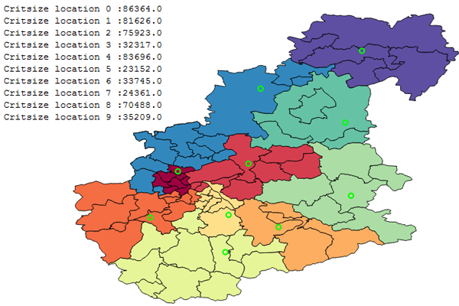
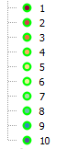
Application to Area Segmentation
Introduction
Motivation
Approach
Architecture
Progress
Outlook
[5]
Balanced criteria
Coherent Areas
Satisfying Compactness rate
17
[1]
Notes:
Applied to area segmentation with some extensions
Balanced criteria by threshold → given by user
Coherent areas: checking connection of neighbour areas
Compactness considered during rearranging using weight function

Slide 18

Application to Greenfieldanalysis
Introduction
Motivation
Approach
Architecture
Progress
Outlook
[5]
Where is the best place for new company locations?
How to distribute areas arround them?
[7]
18
[11]
[1]
Notes:
Greenfieldanalysis: no locations, create them, allocate geometries

Slide 19
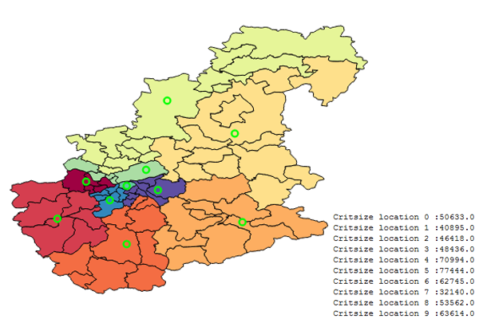
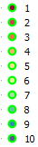
Application to Greenfieldanalysis
Introduction
Motivation
Approach
Architecture
Progress
Outlook
[5]
Creating areas
Creating locations
Same area segmentation approach
Location into middle of area
19
[1]
Notes:
Create start locations
Create ares using DistCrit algorithm
Creating areas using expected value: starting at border geometry and add geometries until criteria is reached; create next area

Slide 20
Application to Greenfieldanalysis
Introduction
Motivation
Approach
Architecture
Progress
Outlook
[5]
Creating areas
Creating locations
Still in progress
Same area segmentation approach
Location into middle of area
20
[1]

Slide 21
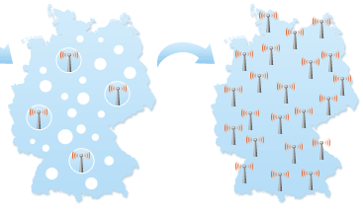

Outlook & Difficulties
Introduction
Motivation
Approach
Architecture
Progress
Outlook
[8]
[4]
Application to Whitespotanalysis
Common Difficulties:
Creating an algorithm with useable results
Performance Issues
21
[1]
Notes:
Whitespot: finding whitespots of a map → have locations + new ones
combination of area segmentation and greenfield → Given locations + adding x new ones
Difficulties:
Useable algorithm
Performance: reduce query to database
Evaluation of results by microm employees supported by their experience
Letzte Folie!!!

Slide 22
References - Sources
http://www.omkt.de/geomarketing/
http://www.microm-online.de/
http://www.mapchart.com/
http://dol.ior.kit.edu/Gebietsplanung.php
http://dol.ior.kit.edu/downloads/Ergebnisse_Visueller_Kompaktheits-Test.pdf
http://www.diedreifragezeichen.de/bachelorarbeit/Seminarvorlage.pdf
http://mapandmarket.ptvgroup.com/de/home/
http://www.easymap24.de/
http://www.gfk.com/de/loesungen/geomarketing/Vertriebsgebietsplanung/Seiten/Vertriebsgebietsplanung.aspx
http://cartogis.de/parallel/geom/gm-vertr.htm
22

Slide 23
References - Images
[1] http://www.microm-online.de/
[2] https://www.kleve.de/c12572b300270277/files/recherche.jpg/$file/recherche.jpg?openelement
[3] http://exista.ecms-fabrik.de/fileadmin/templates/images/Maennchen_mit_Fragezeichen.jpg
[4] http://www.kids-on-cruise.de/mediapool/81/811807/resources/17944837.jpg
[5] https://shop.versicherung-kurzzeitkennzeichen.com/images/checkliste_kurzzeitkennzeichen.png
[6] http://www.port01.com/uploads/cities/13/locations/original/2012-02-03_15%3A53%3A43_sparkasse.jpg
[7] http://www.juergenzwickel.com/wp-content/uploads/2014/12/Ma%CC%88nnchen-auf-Fragezeichen.jpg
[8] https://www.zebradem.com/wiki/images/3/3c/Lte-weisse-flecken.png their contact and experiences with costumers
[9] http://dol.ior.kit.edu/Gebietsplanung.php
[10] http://www.glasdeko24.de/images/produkte/i19/194-sanduhr-kirsche22.jpg
[11] http://bilder.4ever.eu/tag/936/grune-wiese?pg=4
23

Slide 24
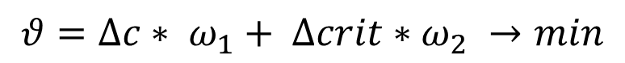
Application to Area Segmentation
Introduction
Motivation
Approach
Architecture
Progress
Outlook
[5]
Balanced criteria
Coherent Areas
Satisfying Compactness rate
17
$$θ=∆c∗ ω_{1}+ ∆crit∗ω_{2} →min$$
[1]
Notes:
Compactness uses compactness rate of cox:
Proportion of the expance of the area to the expance of a circle which have the same circumference like the area
Change of householdnumbers is abberance to expacted value
To get the post zip code areas with best proportion of change of compactness and houshold numbers

